Slide 1

ESE_4009 Embedded Systems Design Project
Task 2: Testing Hardware Components
Submitted To: Prof. Mike Aleshams
Submitted by: Shubham Setia (C0752336)

Slide 2
Overview
Task 2 is based on testing hardware components
This project is called IOT Enabled Beaglebone based smart parking system with SMS alert.

Slide 3
List Of Hardware Components
Beaglebone Black
Ultrasonic sensors
RFID
WiFi module
Gsm Module
Servo motor
Buzzer
Voltage Regulator
Adapter
Soldering Iron Kit with Multimeter
Jumper wires and Bread Board

Slide 4
Arduino IDE
> The Arduino Integrated Development Environment (IDE) is a cross-platform application (for Windows, macOS, Linux) that is written in functions from C and C++. It is used to write and upload programs to Arduino compatible boards, but also, with the help of third-party cores, other vendor development boards.
> The source code for the IDE is released under the GNU General Public License, version 2. The Arduino IDE supports the languages C and C++ using special rules of code structuring.
> The Arduino IDE supplies a software library from the Wiring project, which provides many common input and output procedures. User-written code only requires two basic functions, for starting the sketch and the main program loop, that are compiled and linked with a program stub main() into an executable cyclic executive program with the GNU toolchain, also included with the IDE distribution.

Slide 5
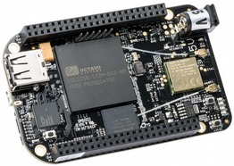
Beaglebone Black Rev C
It will be used as the main microcontroller. Box also includes a miniUSB to USB Type A cable. It is low cost, compact board used to build complex applications.
It is designed to fulfill requirements in fields such as gaming devices, home and industrial automation, consumer medical and intelligent machines and many more.

Slide 6
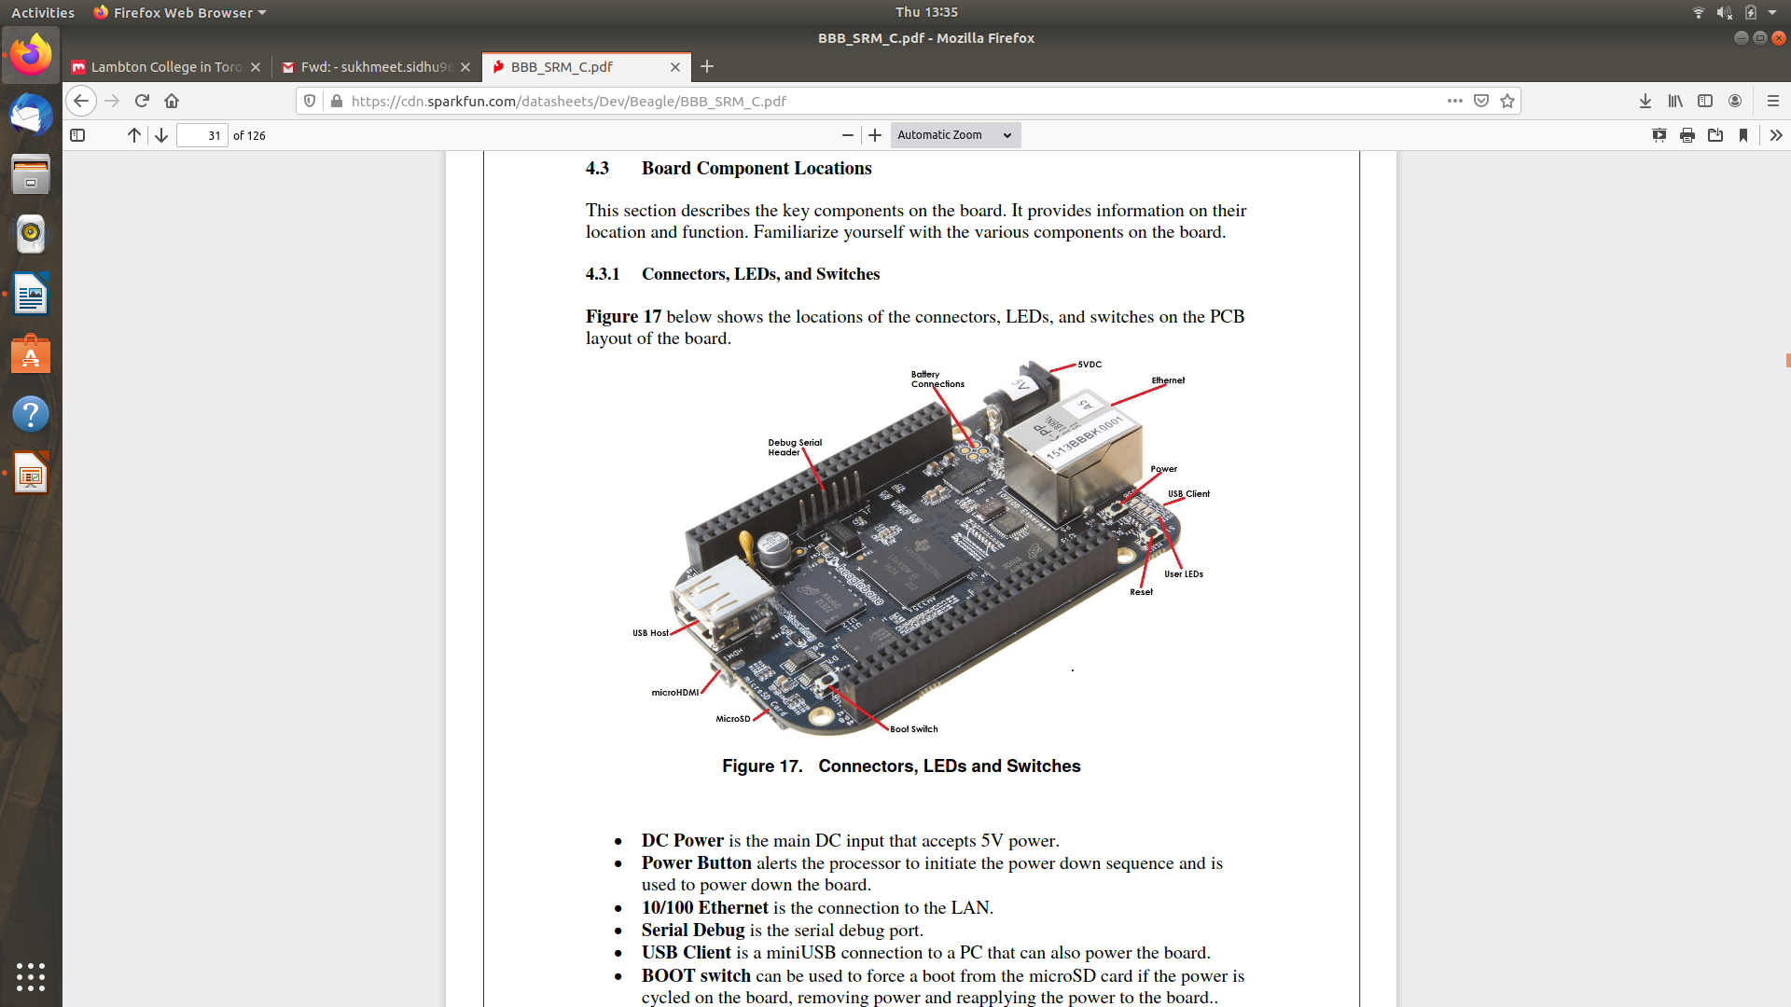
DC power is th emain DC input that accepts 5V power.
Power Button alerts the processor to initiate the power down the sequence and is used to pwer down the board.
BOOT switch can be used to force a boot from the microSD card if the power is cycled on the board, removing power and reapplying the power to the board.
There are four blue LEDS that can be used by the user.
Reset Button allows the user to reset the processor.
MicroSD slot is where a microSD card can be installed.
MicroHDMI connector is where the display is connected to.
USB Host can connected different USB interfaces such as Wi-Fi ,BT , Keyboards, etc.

Slide 7
Key Components
Sitara AM3358BZCZ100 is the processor for the board
Micron eMMC is an onboard MMC chip that holds upto 4GB of data.
HDMI framer provides control for an HDMI with an adapter.

Slide 8
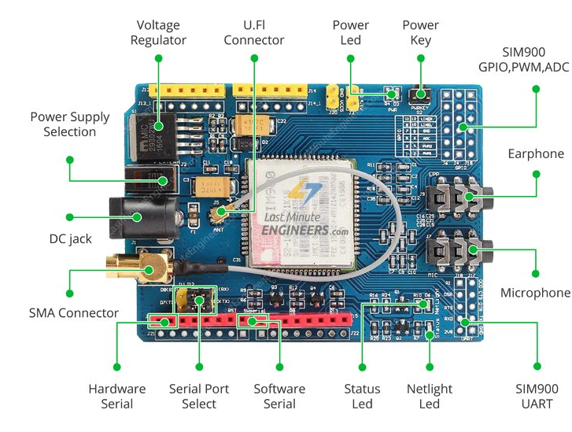
GSM Module-SIM900

Slide 9
SIM900 GSM/GPRS shield is a GSM modem, which can be integrated into a great number of IoT projects. You can use this shield to accomplish almost anything a normal cell phone can; SMS text messages, Make or receive phone calls, connecting to internet through GPRS, TCP/IP, and more! To top it off, the shield supports quad-band GSM/GPRS network.
The SIM900 GSM/GPRS shield uses UART protocol to communicate with an Arduino

Slide 10
Specifications
Connect onto any global GSM network with any 2G SIM
Make and receive voice calls using an external earphone & electret microphone
Send and receive SMS messages
Scan and receive FM radio broadcasts
Accepts Full-size SIM Card

Slide 11
LED Status Indicators-There are three LEDs on the SIM900 GSM/GPRS shield which indicates connectivity or power status.
PWR: This LED is connected to the shield’s power supply line. If this LED is on, the shield is receiving power.
Status: This LED indicates SIM900’s working status. If this LED is on, the chip is in working mode.
Netlight: This LED indicates the status of your cellular network. It’ll blink at various rates to show what state it’s in.
off: The SIM900 chip is not running
64ms on, 800ms off: The SIM900 chip is running but not registered to the cellular network yet.
64ms on, 3 seconds off: The SIM900 chip is registered to the cellular network & can send/receive voice and SMS.
64ms on, 300ms off: The GPRS data connection you requested is active.

Slide 12
GSM module Testing
GSM Module is tested by interfacing it with Arduino Uno in Arduino IDE.
On the serial monitor of IDE, we can communicate with the phone number provided in the code to text or call it as required.

Slide 13
RFID Reader
Radio frequency Identification (RFID) is a wireless identification technology that uses radio waves to identify the presence of RFID tags.
Just like Bar code reader, RFID technology is used for identification of people, object etc. presence.
In RFID technology we just need to bring RFID tags in range of readers. Also, barcodes can get damaged or unreadable, which is not in the case for most of the RFID.
RFID is used in many applications like attendance system in which every person will have their separate RFID tag which will help identify person and their attendance.
RFID is used in many companies to provide access to their authorized employees.
It is also helpful to keep track of goods and in automated toll collection system on highway by embedding Tag (having unique ID) on them.

Slide 14
RFID TAG
RFID tag includes microchip with radio antenna mounted on substrate which carries 12 Byte unique Identification number.

Slide 15
RFID Reader
It is used to read unique ID from RFID tags. Whenever RFID tags comes in range, RFID reader reads its unique ID and transmits it serially to the microcontroller or PC. RFID reader has transceiver and an antenna mounted on it. It is mostly fixed in stationary position.
There are 3 types of RFID Readers:- Active, Passive and active-passive Readers.

Slide 16
RFID Testing
By using RFID Reader and tag with Arduino IDE, testing of RFID is done.
Serial monitor is used to see the output of the reader.
When we bring the Tag near the reader, the reading can be seen on the serial monitor.
Connections made for RFID with Arduino uno are;
Jamp 3.3V – 3.3V
GND – GND
RES – D9
MISO – D12
MOSI – D11
SCK – D13
SDA (SS) – D10

Slide 17
Servo Motor-SG90
Operating Voltage is +5V typically
Operating speed is 0.1s/60°
Rotation : 0°-180°
Package includes gear horns and screws
Used as actuators in many robots like Biped Robot, Hexapod, robotic arm etc..
Commonly used for steering system in RC toys
Robots where position control is required without feedback
Less weight hence used in multi DOF robots like humanoid robots

Slide 18
Servo Motor Testing
Testing of servo motor was fairly easy as it was connected with battery I/O pins to give power to rotors.

Slide 19
WIFI Module ESP32
3 ways to power module:
Micro USB Jack: Connect the mini USB jack to a phone charger or computer through a cable and it will draw power required for the board to function
5V Pin: The 5V pin can be supplied with a Regulated 5V, this voltage will again be regulated to 3.3V through the on-board voltage regulator. Remember ESP32 operated with 3.3V only.
3.3V Pin: If you have a regulated 3.3V supply then you can directly provide this to the 3.3V pin of the ESP32.

Slide 20
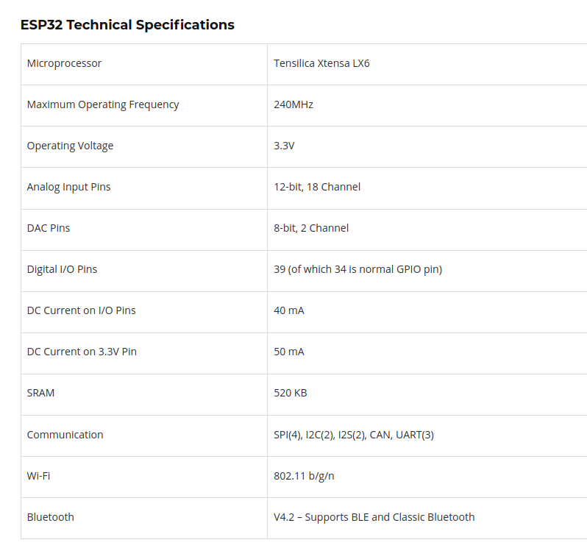

Slide 21
ESP32 Testing
This Wi-Fi module is tested by putting the demo code for hello world!
As the serial monitor on Arduino IDE shows the output “Hello World”, the LED blinks.

Slide 22
Ultra Sonic Sensor-HCSR04
HC-SR04 ultrasonic distance sensor.
This economical sensor provides 2cm to 400cm of non-contact measurement functionality with a ranging accuracy that can reach up to 3mm.
It includes a transmitter, receiver and a control circuits.
4 PINS: VCC(Power), Trigger, Echo(Receive), and GND (Ground)
An additional control circuitry prevents inconsistent “bouncy” data.
The basic principle of work:
1. Using IO trigger for at least 10us high level signal
2. The Module automatically sends eight 40 kHz and detect whether there is a pulse signal back.
3. IF the signal back, through high level , time of high output IO duration is the time from sending ultrasonic to returning.
Test distance = (high level time×velocity of sound (340M/S) / 2

Slide 23

Ultrasonic sensor Testing
Testing for ultrasonic sensor is also done with Arduino Uno in Arduino IDE.
In testing, the following connections are made for ultrasonic sensor with Arduino Uno;
Vcc – Pin 5
Trigger – Pin 10
Echo – Pin 9
Ground – GND
On the serial monitor(Arduino IDE), we can see the output as we near any object with the sensor.

Slide 24
Volatge Regulator-LM2596
A voltage regulator is a system designed to automatically maintain a constant voltage level.
A voltage regulator may use a simple feed-forward design or may include negative feedback. It may use an electromechanical mechanism, or electronic components.

Slide 25
Regulator Type | Step Down (Non Isolated input to Output)
Input Voltage | +4 to 40vdc
Output Voltage | +1.23 to 35 vdc
Output Current | 2A Rated, ( 3A maximum with heat sink)
Switching Frequency | 150kHz
Efficency | Up to 92% ( when output voltage is set high)
Dropout Voltage | 2vdc minimum
Load Regulation | +/- 0.5%
Volatge regulation | +/- 2.5%
Temerature | -40c to +85 deg C

Slide 26
Voltage Regulator Testing
Testing for Voltage Regulator is done with Arduino Uno.
Connection with In+ -> 5V, In- -> GND; Output was tested with multimeter.
We can also adjust potentiometer on the Voltage regulator as required.

Slide 27
Buzzer
A buzzer or beeper is an audio signalling device, which may be mechanical, electromechanical, or piezoelectric (piezo for short).
Typical uses of buzzers and beepers include alarm devices, timers, and confirmation of user input such as a mouse click or keystroke.

Slide 28
Specifications
Color: Black
Driver Circuitry: Transducer
Input Type: Zero-Peak Signal
Frequency: 2Khz
Technology: Piezo
Operating Mode: Ringer
Sound Pressure Level: 70 db@1.5v
Operating Temperature:-20c-70c
Mounting type: Through hole

Slide 29
Buzzer Testing
Buzzer is tested by simply giving power it through the battery.
And, as a successful testing it beeps as the power supplied.

Slide 30
Supporting Hardware
Soldering Kit and multimeter-handskit Soldering Iron Kit, Soldering Iron, 60w 110v Soldering Equipment with Adjustable Temperature Welding Tool and 5pcs Iron Tips, Solder Sucker, Soldering Iron Stand, Solder Wire, Tweezer
Adapter- An adapter or adaptor is a device that converts attributes of one electrical device or system to those of an otherwise incompatible device or system
Jumper wires and PCB boards.

Slide 31
References
https://cdn.sparkfun.com/datasheets/Dev/Beagle/BBB_SRM_C.pdf
https://www.sparkfun.com/products/15569
https://cdn.sparkfun.com/datasheets/Sensors/Proximity/HCSR04.pdf
https://www.digikey.at/product-detail/en/murata-electronics/PKM22EPPH2001-B0/490-4691-ND/1219322
https://components101.com/microcontrollers/esp32-devkitc
https://lastminuteengineers.com/sim900-gsm-shield-arduino-tutorial/
https://www.minikits.com.au/LM2596-PSU-01
https://components101.com/servo-motor-basics-pinout-datasheet
"Arduino - FAQ". www.arduino.cc. Retrieved 2020-08-27.
Hello World with ESP32 Explained. (n.d.). Retrieved October 20, 2020, from https://exploreembedded.com/wiki/Hello_World_with_ESP32_Explained
Roger, Santos, S., K, H., Kumar, V., Rainer, Osorio, R., Balembana. (2019, April 02). SIM900 GSM GPRS Shield with Arduino. Retrieved October 20, 2020, from https://randomnerdtutorials.com/sim900-gsm-gprs-shield-arduino/
Santos, R., Magno, A., Daniel, Sam, Clodoaldo, Duyvestein, D. (2019, April 02). MFRC522 RFID Reader with Arduino Tutorial. Retrieved October 20, 2020, from https://randomnerdtutorials.com/security-access-using-mfrc522-rfid-reader-with-arduino/

